Slide 1
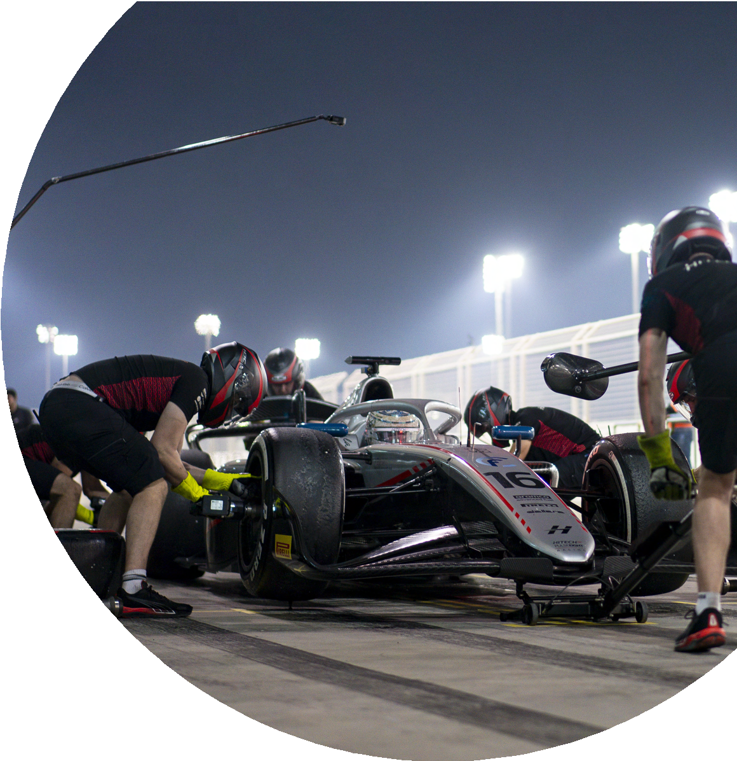
Hitech: One season in… How EventR transformed travel logistics

Slide 2
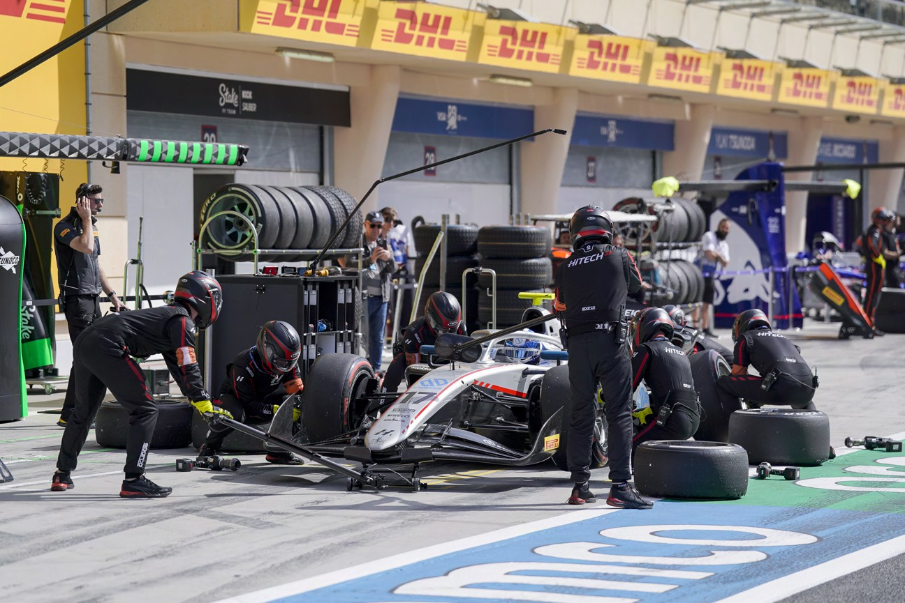
About Hitech
Hitech Grand Prix has been at the forefront of single-seater competition, on both the national and world stage. They have a proven track record in FIA Formula 2, FIA Formula 3, GB3, Formula 4 (British and UAE). They are a winning team, with a reputation for race victories in every championship they compete in.

Slide 3
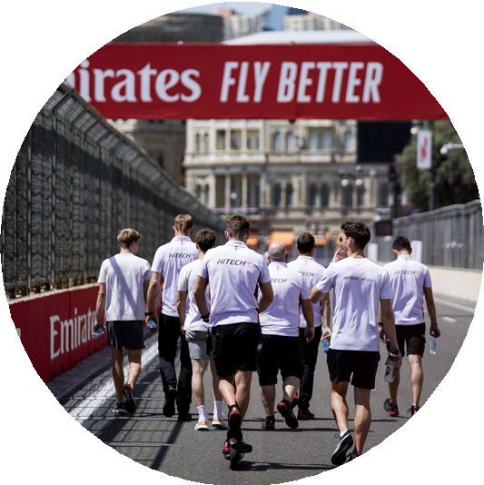
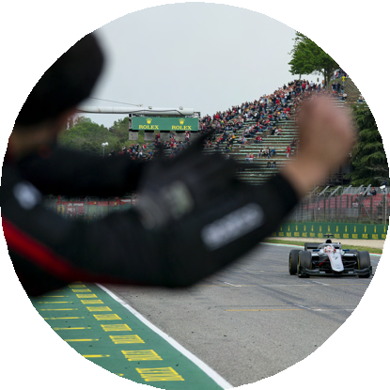
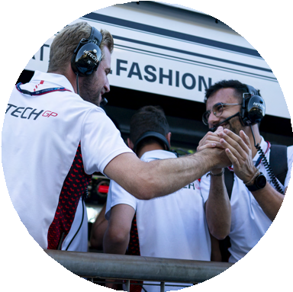
Challenges faced by Hitech
Complex Itinerary Management
Hitech team consists of dozens of individuals, each
with unique travel needs. Coordinating ﬂights, accommodation, transportation, and schedules for various locations, time zones, and venues is certainly complex.
Last-minute changes
Motorsports is a dynamic environment. Last-minute
changes in race schedules, team personnel, or logistics posed a signiﬁcant challenge. Hitech needed a system that could adapt quickly to real-time changes.
Cost Management
Managing travel expenses for a large team across
multiple international locations can easily get out of hand without strict oversight. Tracking costs across different currencies, vendors, and timeframes was a cumbersome task.
Communicating
Communicating complex itineraries before and
during race weekends can be complicated, often done using PDFs and WhatsApp. This requires multiple iterations of a PDF and printed copies. The teams are often in areas with inconsistent signals, making it difficult to see what they are doing.
WhatsApp groups often include everybody travelling, not just the people that require the information.

Slide 4
The EventR Solution
After considering several alternatives, Hitech chose EventR to streamline their travel logistics. The impact was immediate and measurable:
2
Centralised Logistics Platform
Centralised Logistics Platform EventR provided Hitech with a single, centralised platform (the EventR Coordinator Hub) that handled all travel logistics from start to ﬁnish. By controlling the ﬂights, hotels, and local transport through one intuitive dashboard, the team’s logistics manager can oversee every aspect of travel planning without needing multiple tools or services.
Cost Optimization/ Budgeting Tools
EventR’s built-in cost tracking allows Hitech to manage their travel budget effectively. Easily duplicating itineraries enables a comparison between multiple costed plans before deciding on the best one. EventR can export the costs as a spreadsheet for easy integration with accounting systems.
Flexible Itinerary Updates
One of EventR’s standout features is its ability to handle last-minute changes seamlessly. In the
fast-paced world of motorsports, race schedules and team requirements are subject to frequent changes. With EventR, Hitech can quickly adjust travel plans without disrupting the entire schedule. With the press of a button the app is updated for the entire team and this update can be easily communicated using EventR inbuilt chat.
1
3

Slide 5
Improved Data Entry
The EventR Solution
User Responsibility
By having all the information in one
place with automatic updates, the team takes responsibility for the information. This allows for fewer mistakes, ensuring team members don’t miss ﬂights or their onward transport.
4
EventR has reduced the time required for inputting and updating the information for each race.
Copying previous itineraries allows for quickly updating the data. The EventR ﬂight system allows you to quickly update the ﬂight information.
5
6
Data-driven Insights
Having used EventR for a full
season, Hitech can review past trips and gather insights while planning for the next season.
In-built Chat
The inbuilt chat system allows the
team to quickly communicate relevant information to the right people with groups being made for every activity.
7

Slide 6
Key beneﬁts of EventR for Hitech
Reduced Errors
EventR's easy to use interface that
prioritises your next action allows for quick access to information, ensuring smooth travel.
Improved Communication
Real-time updates and in-built chat
ensured that everyone was on the same page, eliminating confusion.
Cost Control
Budgeting through the Coordinator
Hub helps keep the team on target with costs for the season.
Increased Efficiency
Having used EventR for a full
season, Hitech can review past trips and gather insights while planning for the next season.
Scalability
Whether travelling to an event or
coordinating logistics for a full F2 season, EventR scaled with Hitech’s needs effortlessly.

Slide 7
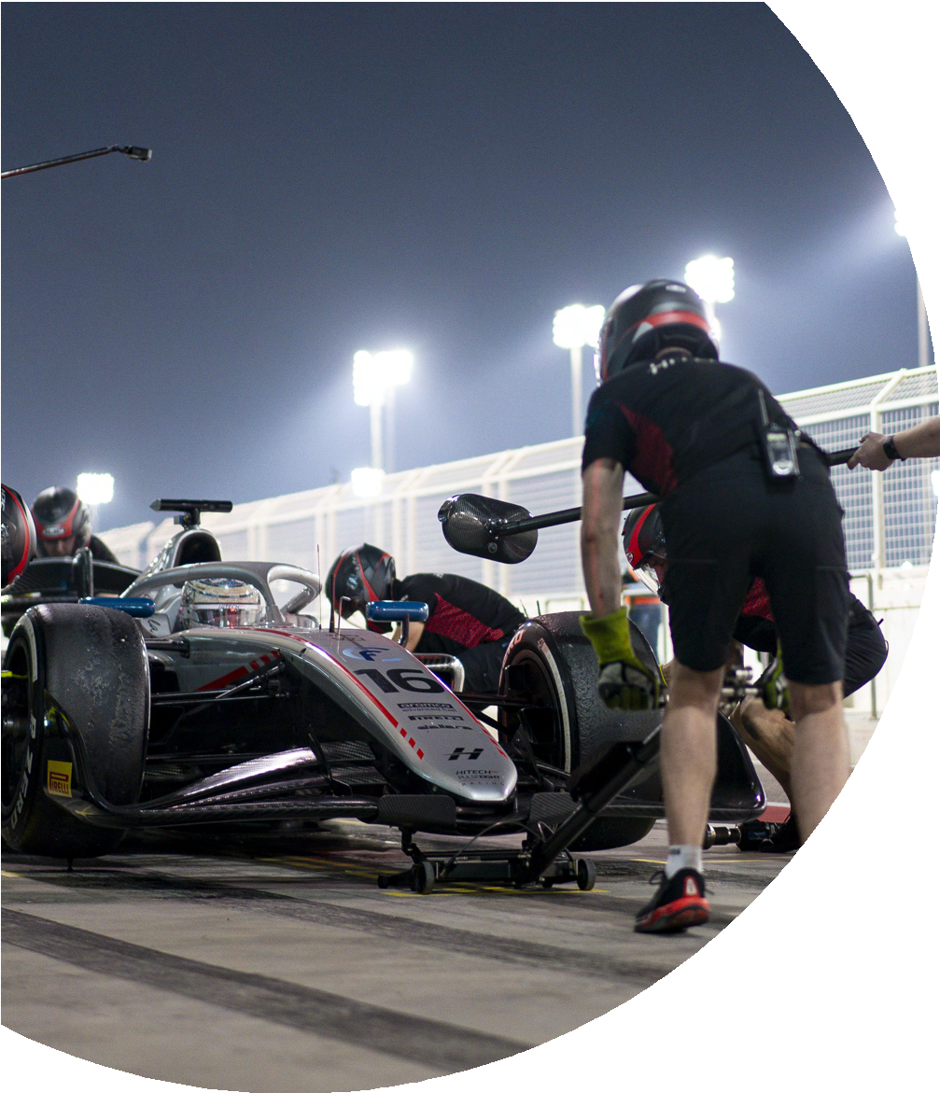
EventR has been a “game-changer for our
team. Managing the travel needs of an entire racing crew can be a complex challenge. The data entry alone for a race weekend used to take me half a day, now it takes half an hour! With EventR, we now have a streamlined process that saves us time, money, and worry. The EventR app is easy to use for the whole team and its offline features mean they can get the information they need anywhere. The platform’s ability to adapt to last-minute changes is impressive, and the cost management tools have helped us stay on budget. EventR is now an essential part of our race operations.
”
Victoria Haynes, Head of Team Coordination, Hitech Grand Prix

